Slide 1




Document intelligence with Azure Open AI
Submitted by -
Bhuvaneshwar V
Devesh S B
Harshavardhini M
Kanika B
Srijith R

Slide 2

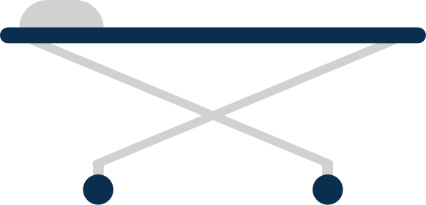
ABSTRACT
For our hackathon project, we developed a Document Intelligence solution using Azure AI, focusing on automating medical form processing in healthcare. By utilizing Azure’s OCR and AI capabilities, our solution can analyze and extract key information from medical prescriptions and patient forms. To manage and store large volumes of data efficiently, we integrated Azure Data Factory, enabling streamlined data handling across hospital records. The final output is visualized in a comprehensive hospital dashboard built in Power BI, presenting insights on patient demographics, treatment trends, and hospital utilization. This project enhances healthcare data management and visualization for better decision-making

Slide 3

Why We Chose This Project?
Solving a Real-World Healthcare Challenge
Manual Data Entry Issues: Traditional patient data management is time-consuming, error-prone, and inefficient, especially when dealing with handwritten or paper forms.
Fragmented and Inconsistent Data: Healthcare data is often stored across multiple formats and systems, leading to inconsistent and fragmented records that are hard to consolidate. This lack of a unified digital system makes it difficult for healthcare providers to gain a complete view of a patient’s history.
Limited Real-Time Access to Insights: Without automated systems, healthcare providers face delays in accessing up-to-date patient insights. This limits their ability to make fast, data-driven decisions, especially in emergency situations where timely data access is critical for effective treatment.

Slide 4
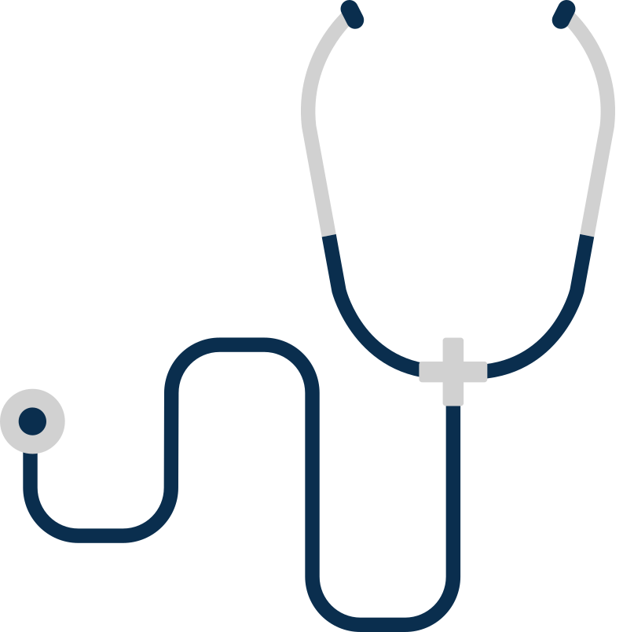
Enhancing Data Usability and Insights
- Instant Summarization & Querying: By allowing users to ask questions and receive immediate summaries, healthcare workers can make faster, informed decisions.
- Data Visualization: Connecting to Power BI offers visual insights into patient trends, making it easier to understand critical health patterns.
Automating a Key Process in Healthcare
- Accuracy and Reliability: Using Azure Document Intelligence ensures high accuracy in data extraction and consistency in handling large volumes of documents.
- Scalability: This project can be scaled for use in multiple healthcare facilities, streamlining patient record management across organizations.

Slide 5



Ideas and Approach
Approach Breakdown
Data Extraction with Azure Form Recognizer:
Utilizing Azure’s Document Intelligence to process forms, extract structured information, and convert it to digital formats.
Summarization & Querying Using OpenAI:
Implementing OpenAI’s API to support natural language queries, allowing users to ask specific questions about a patient’s records and receive immediate responses.
Data Storage and Accessibility:
Setting up Azure Blob Storage for document storage and retrieval, creating a secure, organized space for patient records.
Visualization with Power BI:
Integrating Power BI to create visual dashboards for insights, showing trends and statistics in patient data for better healthcare insights.
Idea Development
User-Centric Design: Focused on creating a tool that healthcare providers find easy to use and accessible, enabling them to quickly find patient data without going through manual records.
Integration with Azure Services: Leveraging Azure's Document Intelligence and OpenAI services to make the solution more robust, automated, and reliable.

Slide 6
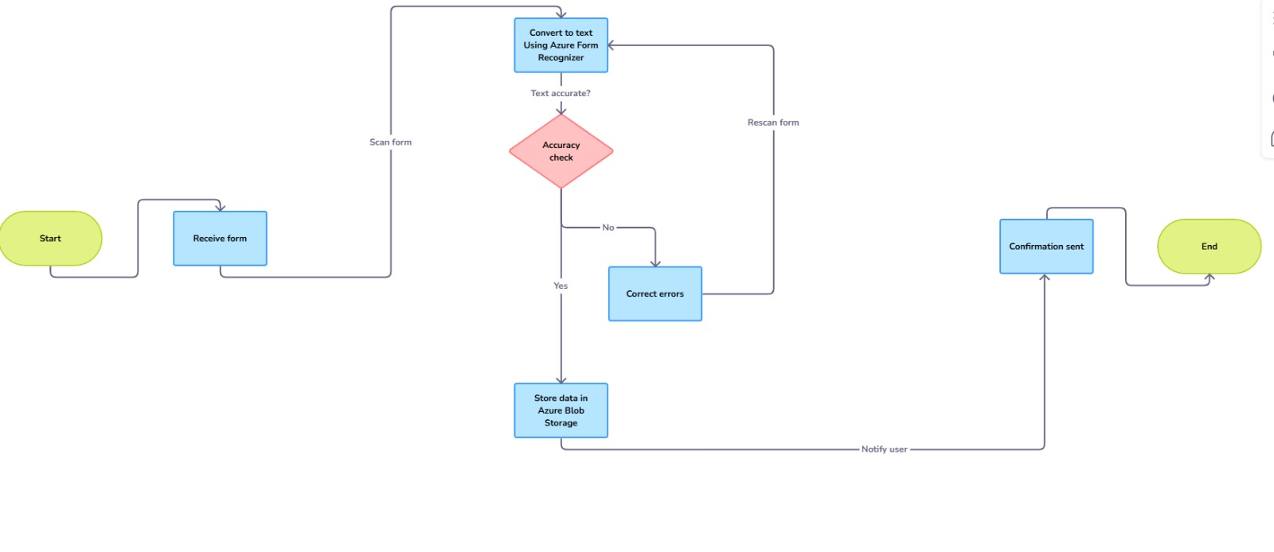
Flow Chart For data extractions

Slide 7
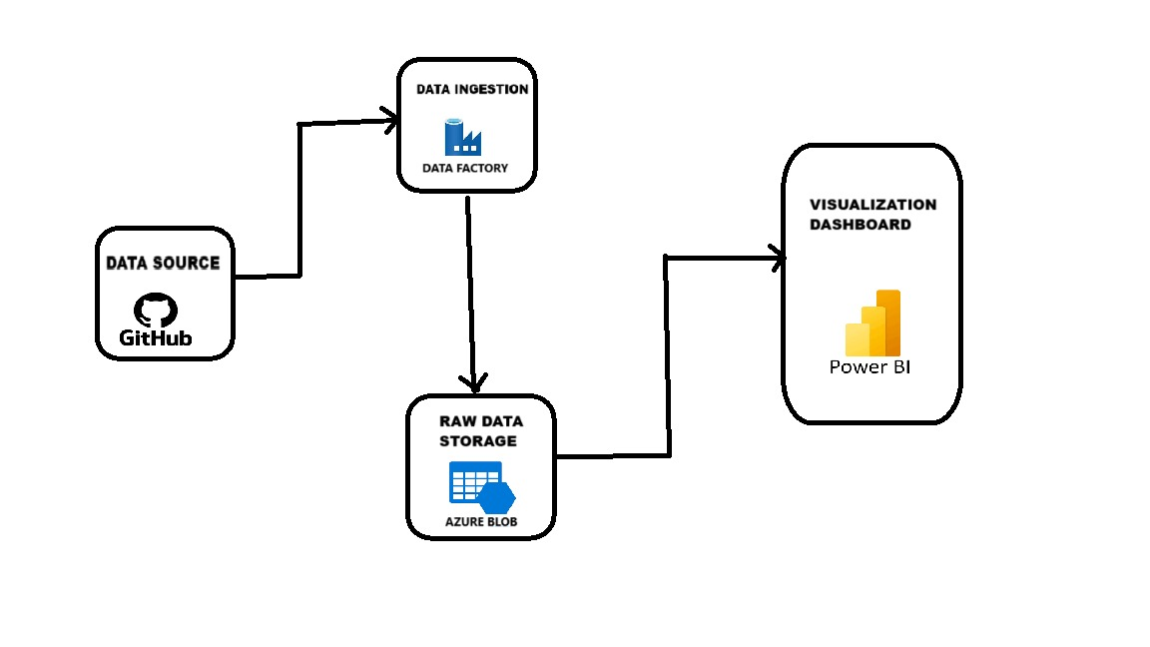
Flow Chart For data Visualization

Slide 8
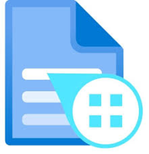


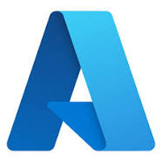
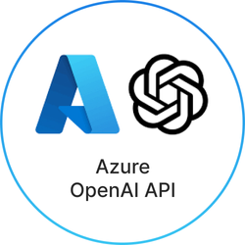

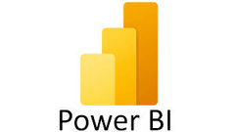
HIGHLIGHTS
AZURE DOCUMENT INTELLIGENCE
AZURE OPEN AI
AZURE DATA FACTORY
DATA VISUALIZATION

Slide 9

End Goal and Vision
Enhanced Patient Experience
By minimizing paperwork and ensuring swift data retrieval, healthcare providers can improve the patient experience, leading to higher satisfaction and more personalized care.
Data-Driven Decision-Making
With automated data extraction, summarization, and visualization, providers gain quick access to actionable insights, helping them make more accurate, data-informed decisions in a timely manner.
Scalable Solution for Diverse Healthcare Settings
This project is designed to be scalable across various healthcare environments, from small clinics to large hospitals, ensuring that providers at all levels can benefit from streamlined data management.
Security and Compliance
Digitalized records allow for better data security and compliance with healthcare regulations (e.g., HIPAA), reducing the risk of data breaches and ensuring patient confidentiality.

Slide 10

THANK YOU

